Slide 1
Introduction to R

Slide 2
Goals for Today
Downloading R and R Studio
R Overview
Installing Packages
Basics of R Programming
Other Helpful Tools for Classes with R
Additional Resources
2
Notes:
2

Slide 3
Downloading R and R Studio

Slide 4
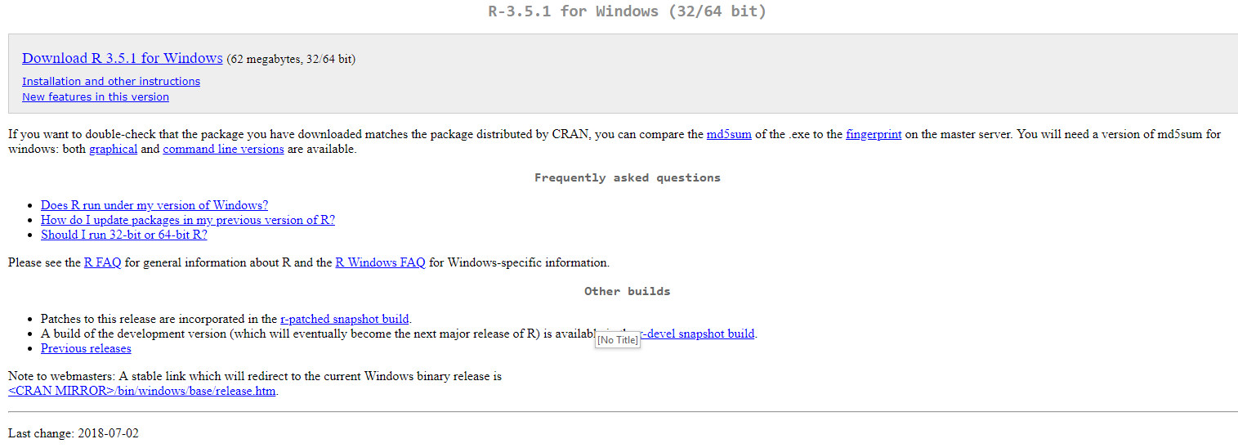
Downloading and Installing R
Navigate to https://www.r-project.org/ and click on “CRAN” underneath the “Download” section of the sidebar. Select the mirror of your choice (the closest is probably https://ftp.ussg.iu.edu/CRAN/) and download the appropriate version of R for your Operating System. If asked, download the “base” subdirectory.
You should be able to accept all the default values in the installer.
4
Notes:
4

Slide 5
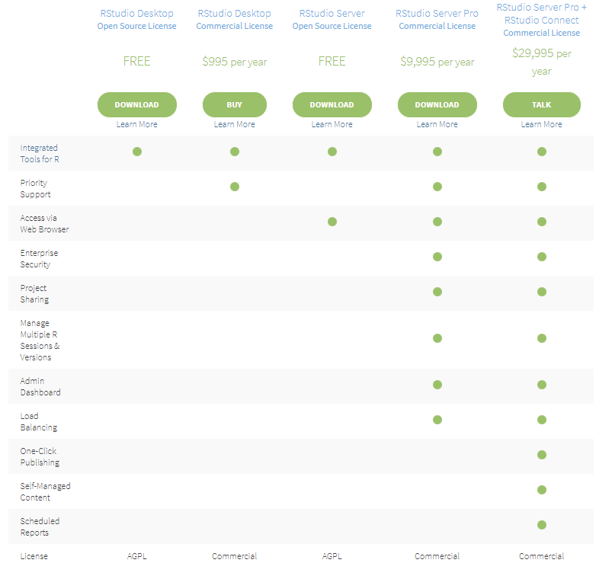
Downloading and Installing R Studio
Navigate to https://www.rstudio.com/products/rstudio/download/ and download “R Studio Desktop” for your operating system. Again, you can use the default installation options.
5
Notes:
5

Slide 6

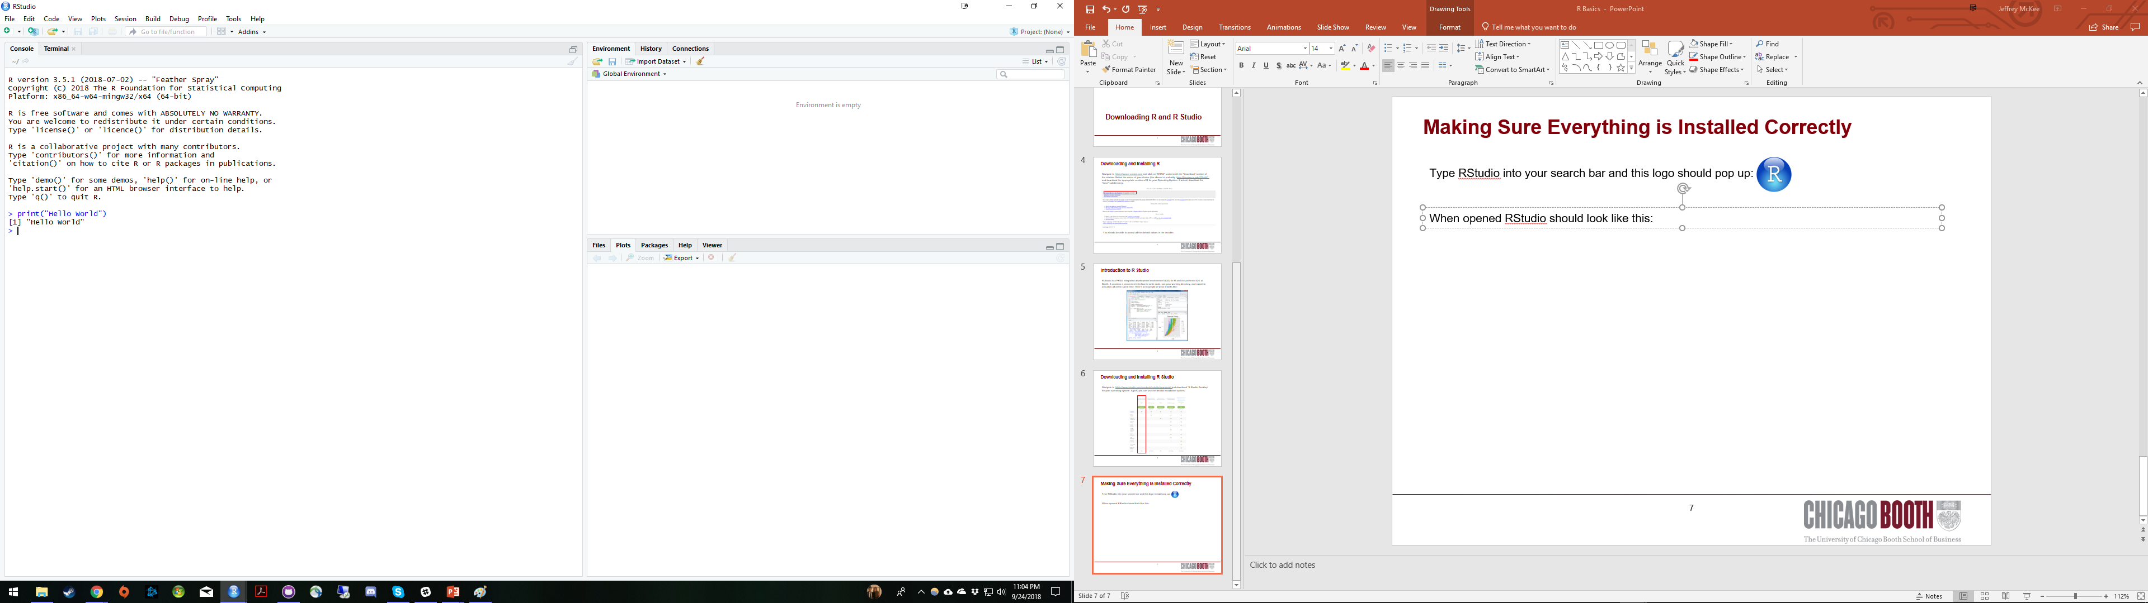

Making Sure Everything is Installed Correctly
Type RStudio into your search bar and this logo should pop up:
Open R studio and try typing in print(“Hello World!”) to make sure everything is working as intended:
Feel free to also trying asking R to perform some basic calculations!
6
Notes:
6

Slide 7
What is R?

Slide 8
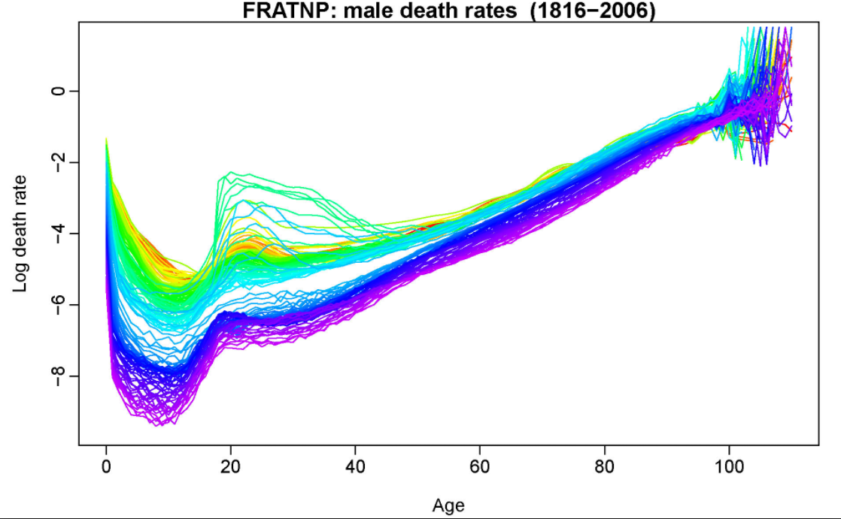
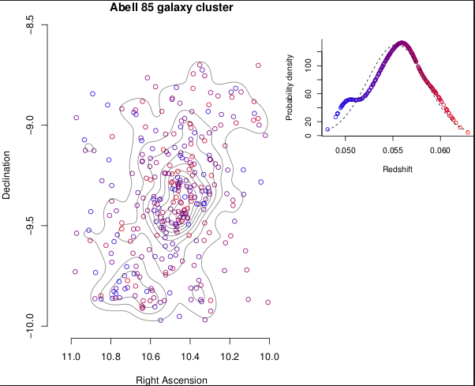
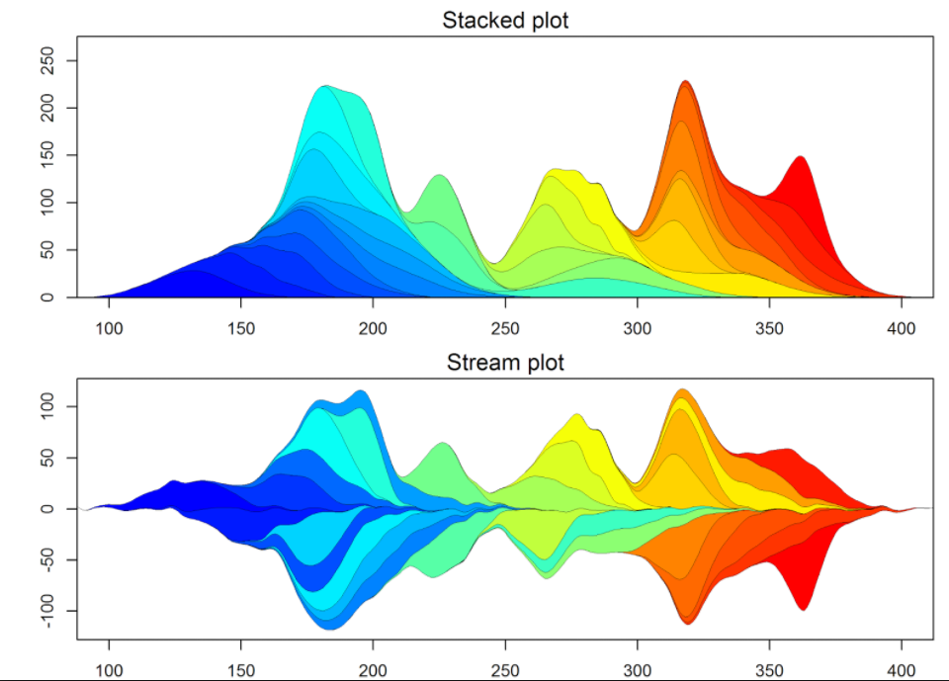
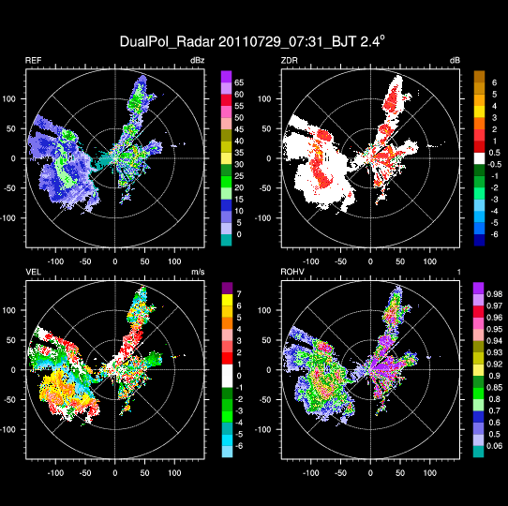
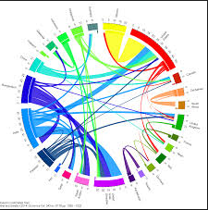
What is R?
R is an open source (thus FREE) programming language for statistical computing and plotting that is supported by the R Foundation for Statistical Computing. R is widely used among academics, statisticians, and data scientists for data analysis and is the default statistical programming language here at Booth.
R’s primary strength is its support of user-written packages that allow you to easily run complicated/state of the art analyses without having to write (or necessarily even understand) the code yourself. In particular, R’s visualization packages are considered best-in-class.
8
Notes:
8

Slide 9
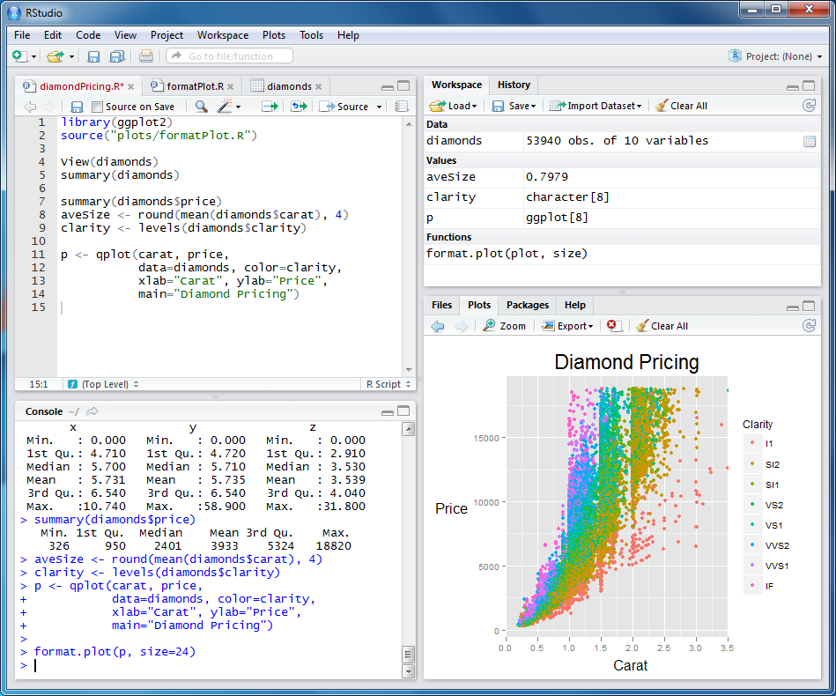
What is R Studio?
R Studio is a FREE integrated development environment (IDE) for R and the preferred IDE at Booth. It provides a convenient interface to write and test code, see your working directory, and examine plots/read help files all at the same time.
9
Notes:
9

Slide 10
Typical Booth Workflow

Slide 11
Booth Workflow
Read in data
Check data – List variables, their type, range, number of missings, plot distribution, descriptive statistics, etc.
Clean data – Resolve missings, transform variables, etc.
Test models – Check significance, residuals, goodness of fit, etc.
Visualize data
11
Notes:
11

Slide 12
Installing Packages

Slide 13
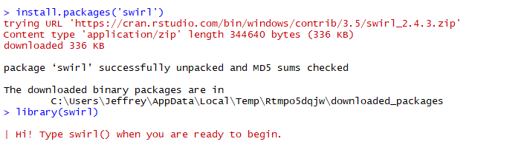
Installing and Loading Packages in R
One of the key strengths of R is the fact that so many R developers have written packages and shared them with the larger community through CRAN (the Comprehensive R Archive Network). Base R allows you to install and load these packages directly through the R interface with the install.packages() and library() functions. The package that we are going to install and use today is “swirl”, a software package for learning R, directly in R!
Type ‘install.packages(“swirl”)’ followed by ‘library(swirl)’.
This is exactly the same process you will use to install and load any R packages that you may need in the future
13
Notes:
13

Slide 14
Getting Started with Swirl

Slide 15
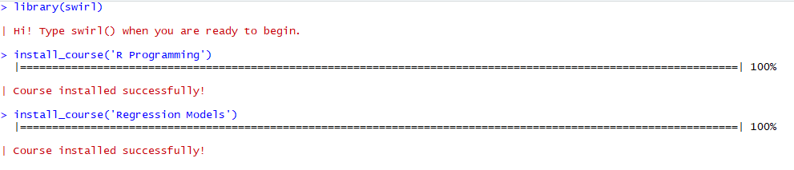
Swirl Courses to Install
Swirl courses can be installed with the following function (which we downloaded when installing the swirl package): install_course().
Let’s install the “R Programming” and “Regression Models” courses by typing install_course(“R Programming”) and install_course(“Regression Models”)
15
Notes:
15

Slide 16
Swirl Lessons to Try
After using the swirl() function to open swirl, it will list the courses you have installed. After selecting a course, it will then list lessons for you to select. We will work through the following:
R Programming:
1. Basic Building Blocks
5. Missing Values
6. Subsetting Vectors
7. Matrices and Data Frames
16
Notes:
16

Slide 17
Basics of R Programming

Slide 18
Basic Building Blocks and Missing Values Takeaways
You can pull up the help section for a function by at any time by typing ? followed by the function
You can create variables to store values by using the “<-” or “=“ operators
A vector is a data structure that contains one or more observations
The c() command combines observations into a vector
Operations on a vector will be performed on each item sequentially, and recycled if two vectors in the operation are of different lengths
Any operation on an NA will yield an NA, except for is.na()
Additional Notes:
Comment your code by starting a line with the ‘#’ symbol
18
Notes:
18

Slide 19
Subsetting Vectors Takeaways
Reference a subset of a vector using brackets, e.g. x[1:10], R is a one-based indexing language
There are four type of subsetting: 1. positive integers, 2. logicals, 3. negative integers, 4. character strings
Positive integers: x[1:10] will return observations 1 through 10
Logicals: x[x>10] will return observations for which x exceeds 10
Negative integers: x[-1] will return all observations EXCEPT 1
Character strings: mtcars[“mpg”] returns the column named “mpg”
19
Notes:
19

Slide 20
Matrices and Data Frames Takeaways
A matrix is like a vector but in 2 dimensions, x and y
A dataframe is a two dimensional data structure that allows for multiple data types
Additional Notes:
1. You can reference a named column using the “$” operator, e.g. mtcars$mpg
20
Notes:
20

Slide 21
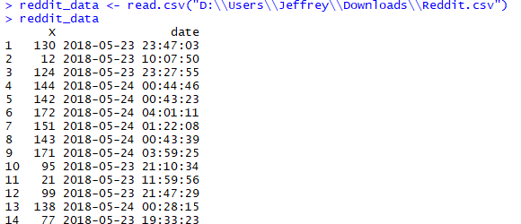
Loading .csv Files into R
In your classes, you will be asked to read in data from .csv files. This is done using the read.csv() function. Note that filepaths require two “\” symbols in Windows! In mac use just one “/”
21
Notes:
21

Slide 22
Other Tools for Programming Classes

Slide 23
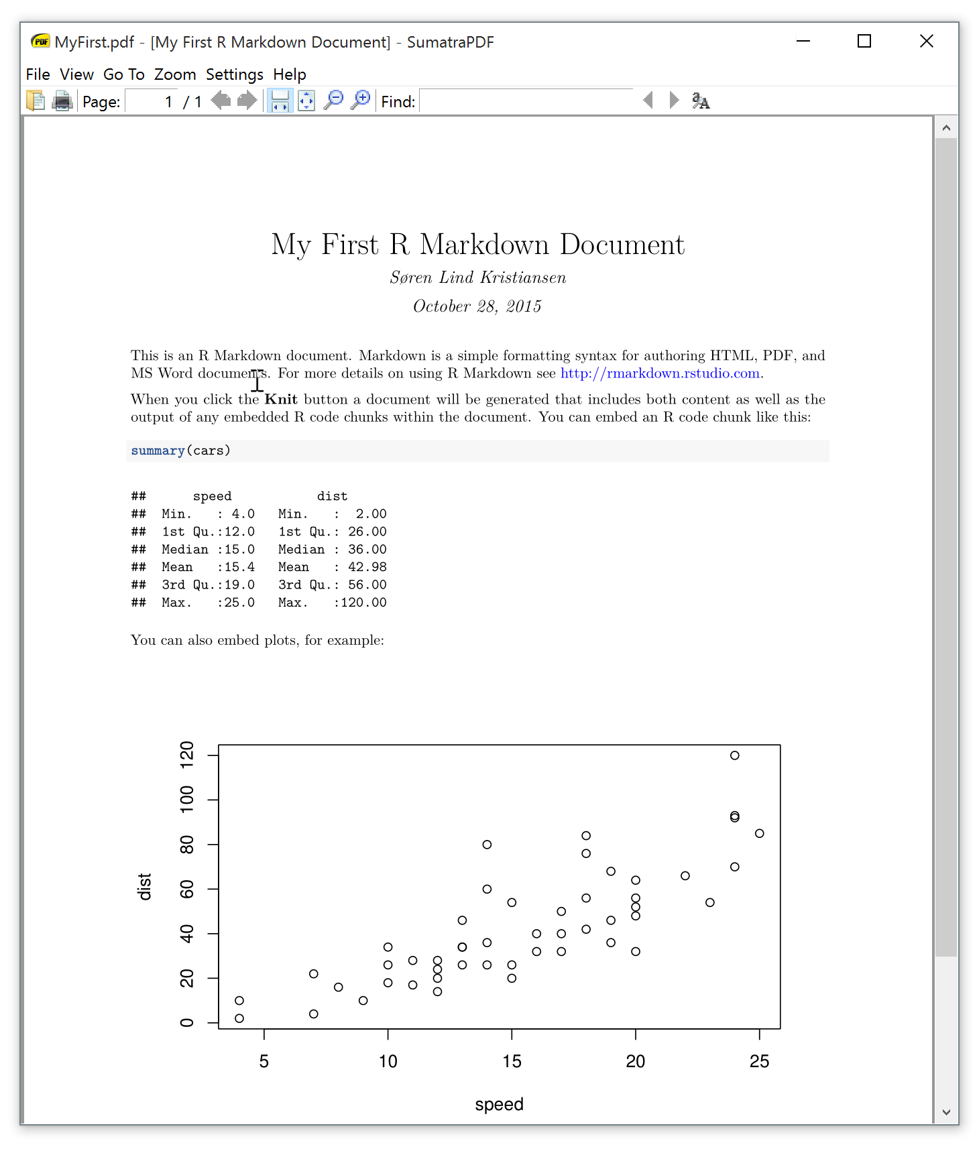
R Markdown
R Markdown is a really useful package that allows you to create a document directly in R, making it very simple to include exhibits or outputs. We highly recommend you try R Markdown if you are taking a class that requires write ups of your R homework. See: https://rmarkdown.rstudio.com/
23
Notes:
23

Slide 24
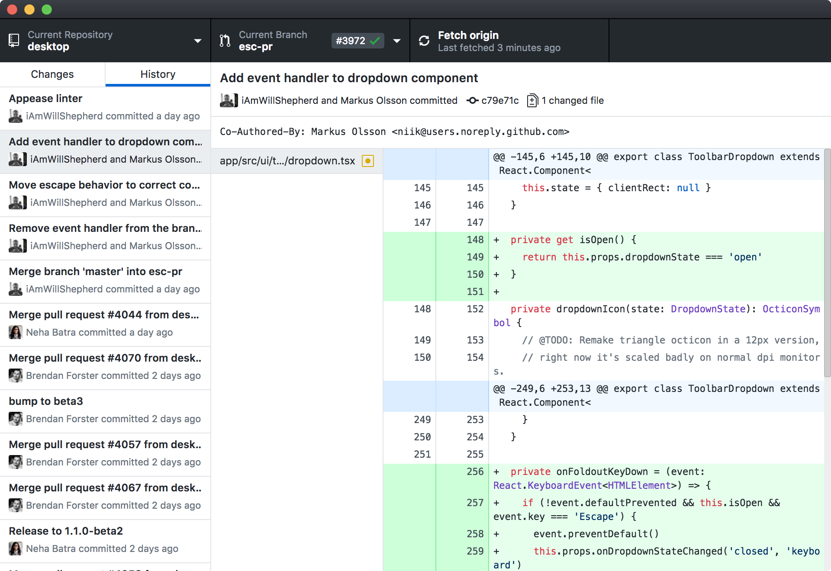
GitHub
This is outside the scope of this introduction but you’ve probably heard of GitHub and we recommend you consider using it for your group assignments. You can find out more here: https://guides.github.com/activities/hello-world/.
24
Notes:
24

Slide 25
Wrap Up

Slide 26
Preview of Next Week’s Intermediate R Session
We will walk through an example exercise, step by step:
Read in data
Check data – List variables, their type, range, number of missings, plot distribution, descriptive statistics, etc.
Clean data – Resolve missings, transform variables, etc.
Test models – Check significance, residuals, goodness of fit, etc.
Visualize data
26
Notes:
26

Slide 27
More Resources
https://www.rstudio.com/resources/cheatsheets/
https://swirlstats.com/
https://www.datacamp.com/
http://tryr.codeschool.com/
Or just ask! jmejiare@chicagobooth.edu or jmckee0@chicagobooth.edu
27
Notes:
27

